Slide 1
What is recyclable and what is not?
By the Eco Council.

Slide 2
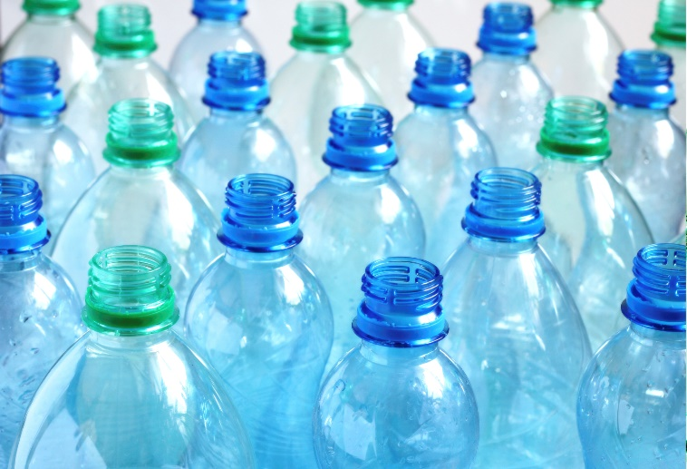

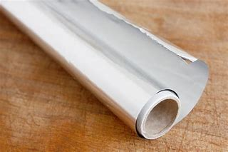
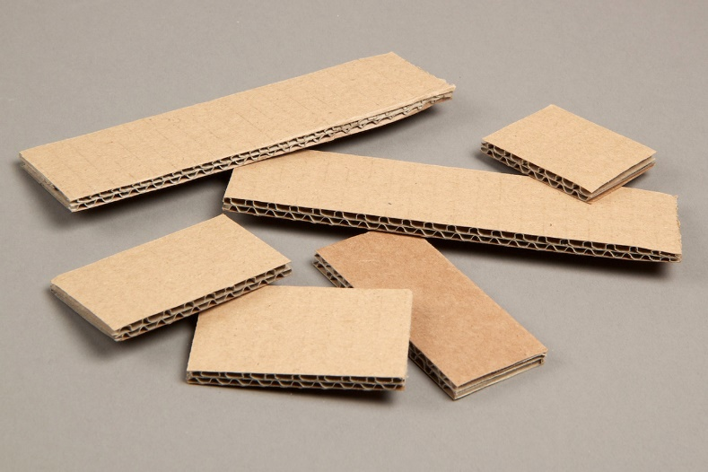
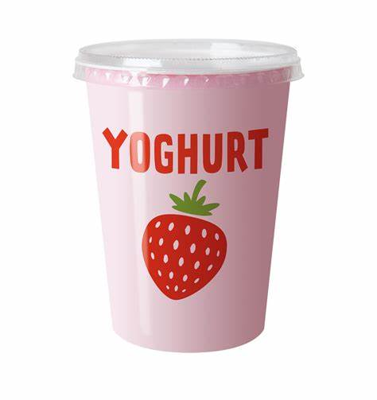
What is recyclable?
. Magazines
. Card
. Cardboard
. Plastic bottles
. Food trays
. Yoghurt pots
. Ice cream tubs
. Margarine tubs
. Tin foil
. Food tins
. Drink cans
. Biscuit/sweet tins
. Metal bottle tops
. Plastic lids

Slide 3
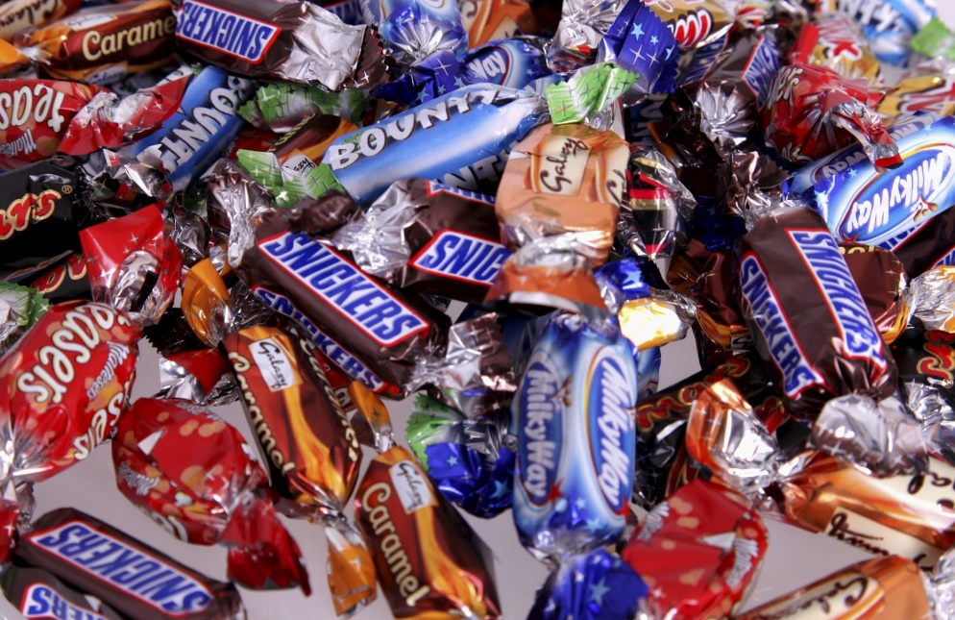
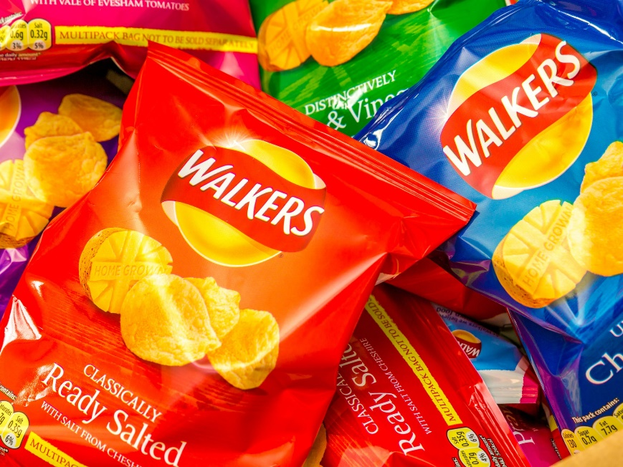
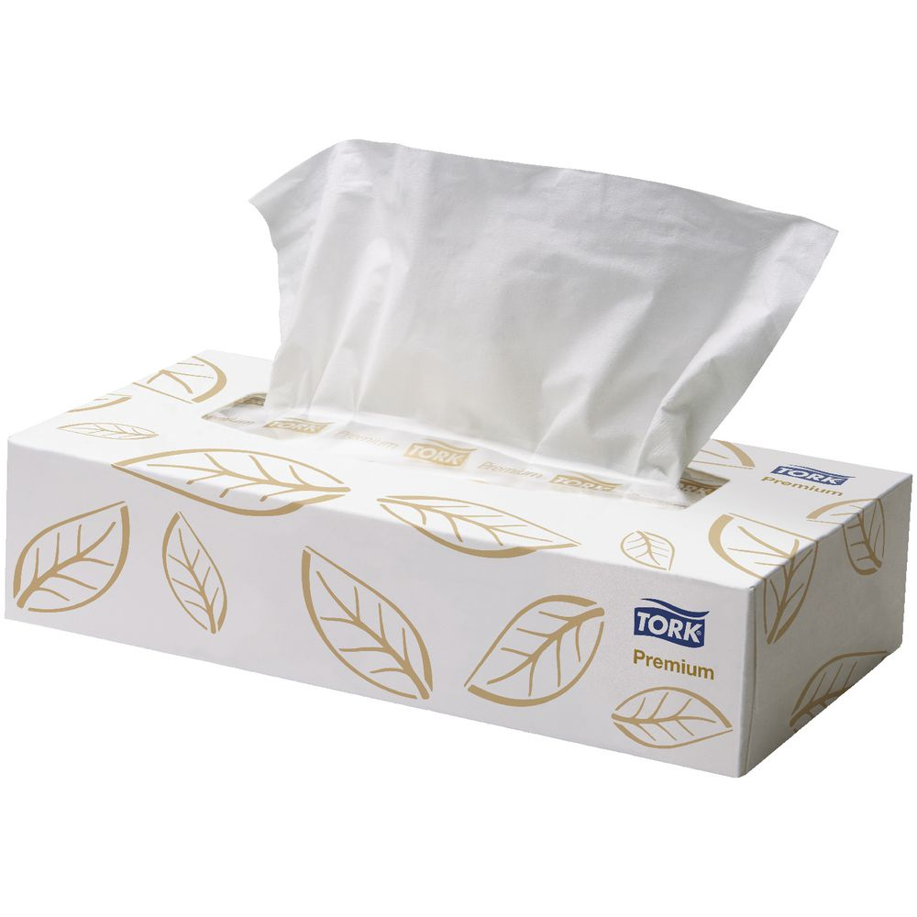
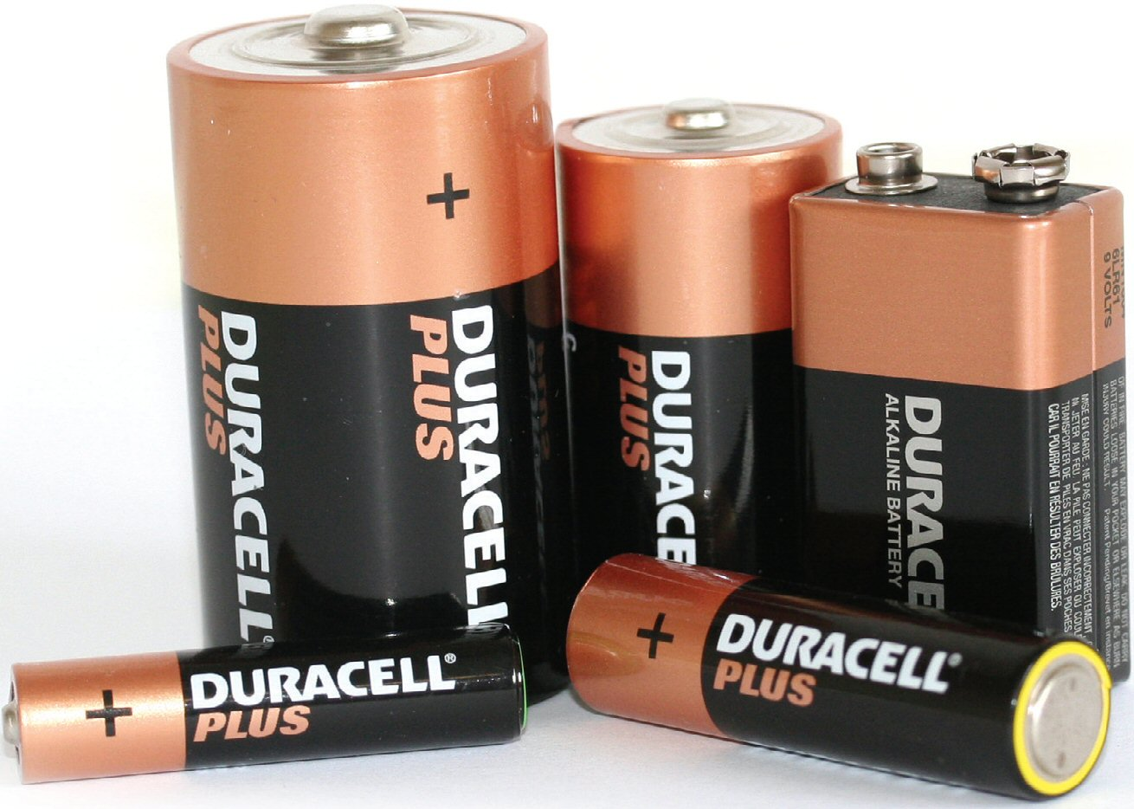
What is not recyclable?
. Polystyrene
. Batteries
. Sweet/crisp wrappers
. Food waste
. Tissues
. Medical waste
. Large plastic items

