Slide 1
Assessment

Slide 2


"Gathering feedback on how well pupils have learned a topic is important in enabling teachers to address any misunderstanding and provide the right level of challenge in future lessons."
Assessment should be used to plan appropriate teaching and learning strategies, including to identify children and learners who are falling behind in their learning or who need additional support, enabling children and learners to make good progress and achieve well.

Slide 3
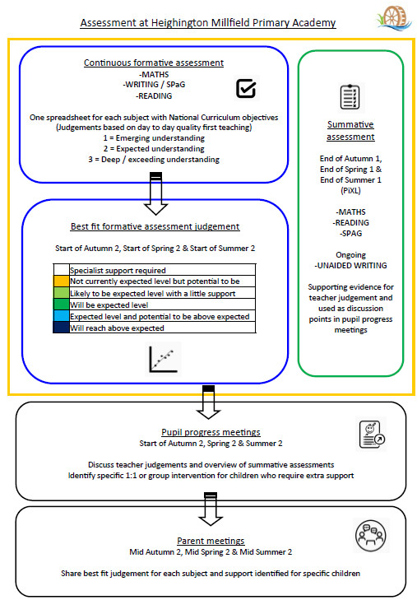

Slide 4




Our termly cycle
Day to day assessment
EYFS – Early learning goals
Y1–6 = Personalised Learning Checklists
PIXL assessments
KS1 onwards
Share with
Parents – All year groups
Pupil progress
Meetings – All staff

Slide 5
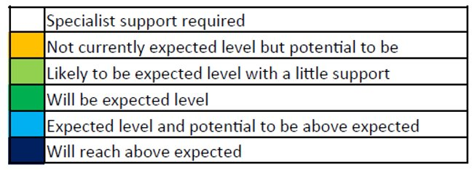
Moving through the school
Teacher judgements and parent meetings
EYFS
On track / Not on track for ‘expected’
Year 1 – 6
Consistent vocabulary used each term

Slide 6
Discussing progress
In pupil progress meetings (Module 2, 4 and 6)
EYFS
Communication and language
Physical Development
Personal Social Emotional Development
Literacy / Maths
Pupil groups
SEND
Wellbeing

Slide 7
Discussing progress
In pupil progress meetings (Module 2, 4 and 6)
KS1
Reading
Writing
Maths
Pupil groups – Forces / FSM / LAC etc..
SEND
Wellbeing

Slide 8
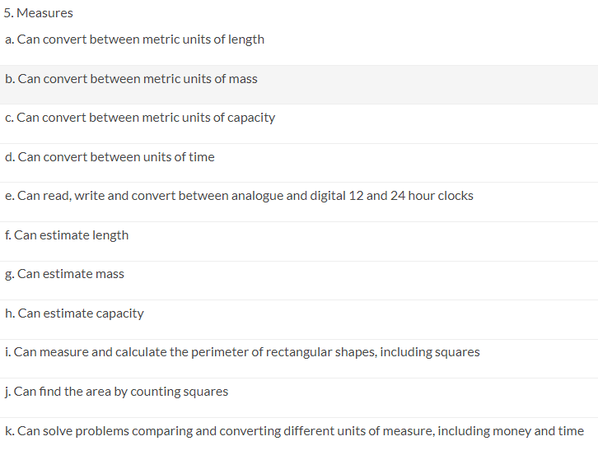
Children needing extra support
(EYFS - class based support)
(Y1 - 6 PiXL interventions)
Year 4
Maths
Measures

Slide 9
Learning pathway
Quality first teaching
Children requiring specific support (Intervention)
Children requiring further support (SEND)

Slide 10
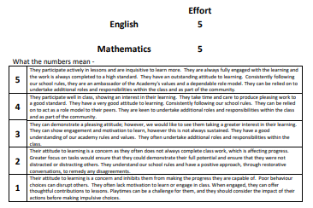

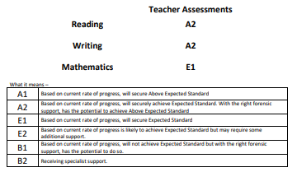
Parents evening / Reports

Slide 11
Statutory assessments
At various points in a child's primary school life, if a child is able to access the assessments, they will carry out national statutory assessments.
These assessments focus on children's knowledge and understanding of the national curriculum.
Examples of these assessments are available

Slide 12
Assessment in EYFS
Assessment in the EYFS is carried out using the early learning goals ; the assessment is on-going during the academic year. There are 2 statutory assessments in Reception
Reception Baseline Assessment (RBA) - start of Reception (September)
Communication and language / Literacy / Mathematics
EYFS profile – end of Reception (June)
Communication and Language
Physical Development
Personal and Social Development
Literacy
Mathematics
Understanding the World
Expressive Arts and Design

Slide 13
Taking part in the statutory assessments
Some children will not sit the assessments
Some children will sit the assessments with a variety of access arrangements e.g. scribe / transcribe / rest breaks / readers / word processing / electronic aids
Some children will sit the assessments without support

Slide 14


Statutory assessments
Key stage 1 (Year 1 and 2)
Phonics screening check (Year 1) - Term 6
SATs (Year 2) - May
Reading
Mathematics 1 and 2
SPaG (Grammar and Spelling)
Writing judgements from class work

Slide 15
Our 21/22 HIGHLIGHTS
Phonics Screening Check (Y1)
80% + pass
SATS (Y2)
Higher than national average in Maths
Higher than national average in Reading
20% higher than national average in Writing

Slide 16
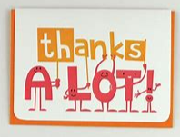

Thank you
Questions?

