Slide 1
Assessment

Slide 2


"Gathering feedback on how well pupils have learned a topic is important in enabling teachers to address any misunderstanding and provide the right level of challenge in future lessons."
Assessment should be used to plan appropriate teaching and learning strategies, including to identify children and learners who are falling behind in their learning or who need additional support, enabling children and learners to make good progress and achieve well.

Slide 3
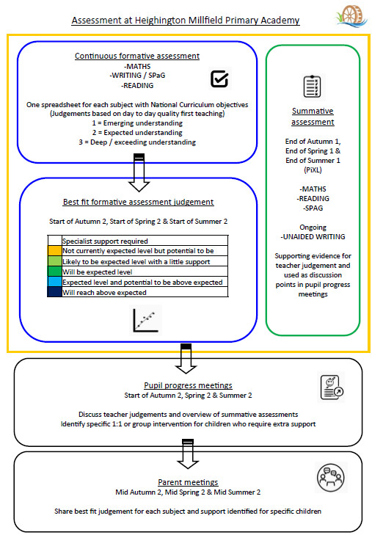

Slide 4




Our termly cycle
Day to day assessment
EYFS – Early learning goals
Y1–6 = Personalised Learning Checklists
PIXL assessments
KS1 onwards
Share with
Parents – All year groups
Pupil progress
Meetings – All staff

Slide 5
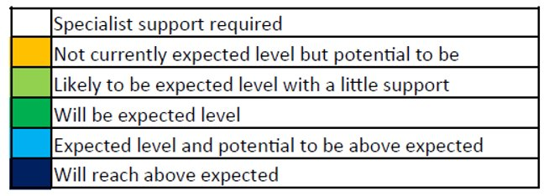
Moving through the school
Teacher judgements and parent meetings
EYFS
On track / Not on track for ‘expected’
Year 1 – 6
Consistent vocabulary used each term

Slide 6
Discussing progress
In pupil progress meetings (Module 2, 4 and 6)
KS2
Reading
Writing
Maths
Pupil groups
SEND
Wellbeing

Slide 7
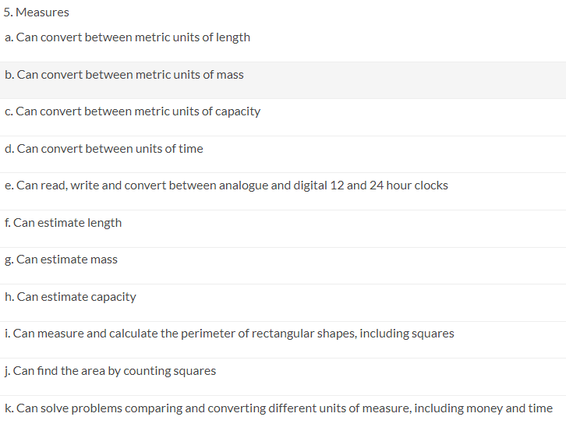
Children needing extra support
(EYFS - class based support)
(Y1 - 6 PiXL interventions)
Year 4
Maths
Measures

Slide 8
Learning pathway
Quality first teaching
Children requiring specific support (Intervention)
Children requiring further support (SEND)

Slide 9
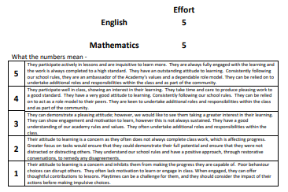

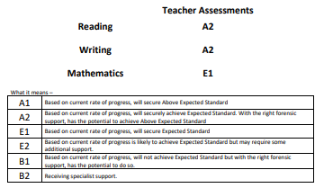
Parents evening / Reports

Slide 10
Statutory assessments
At various points in a child's primary school life, if a child is able to access the assessments, they will carry out national statutory assessments.
These assessments focus on children's knowledge and understanding of the national curriculum.
Examples of these assessments are available

Slide 11
Taking part in the statutory assessments
Some children will not sit the assessments
Some children will sit the assessments with a variety of access arrangements e.g. scribe / transcribe / rest breaks / readers / word processing / electronic aids
Some children will sit the assessments without support

Slide 12


Statutory assessments
Key stage 2 (Year 3,4 5 and 6)
Multiplication tables check (Year 4) - Term 6
SATs (Year 6) - w.b. 8th May
Reading
Mathematics 1, 2 and 3
SPaG (Grammar and Spelling)
Writing judgements from class work

Slide 13
Our 21/22 HIGHLIGHTS
Phonics Screening Check (Y1)
80% + pass
SATS (Y2)
Higher than national average in Maths
Higher than national average in Reading
20% higher than national average in Writing
SATS (Y6)
Over 10% higher than national average in Reading
Higher than national average in Maths and Writing
Over 10% higher than national average for RWM combined

Slide 14
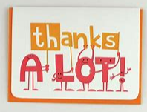

Thank you
Questions?

